Slide 1


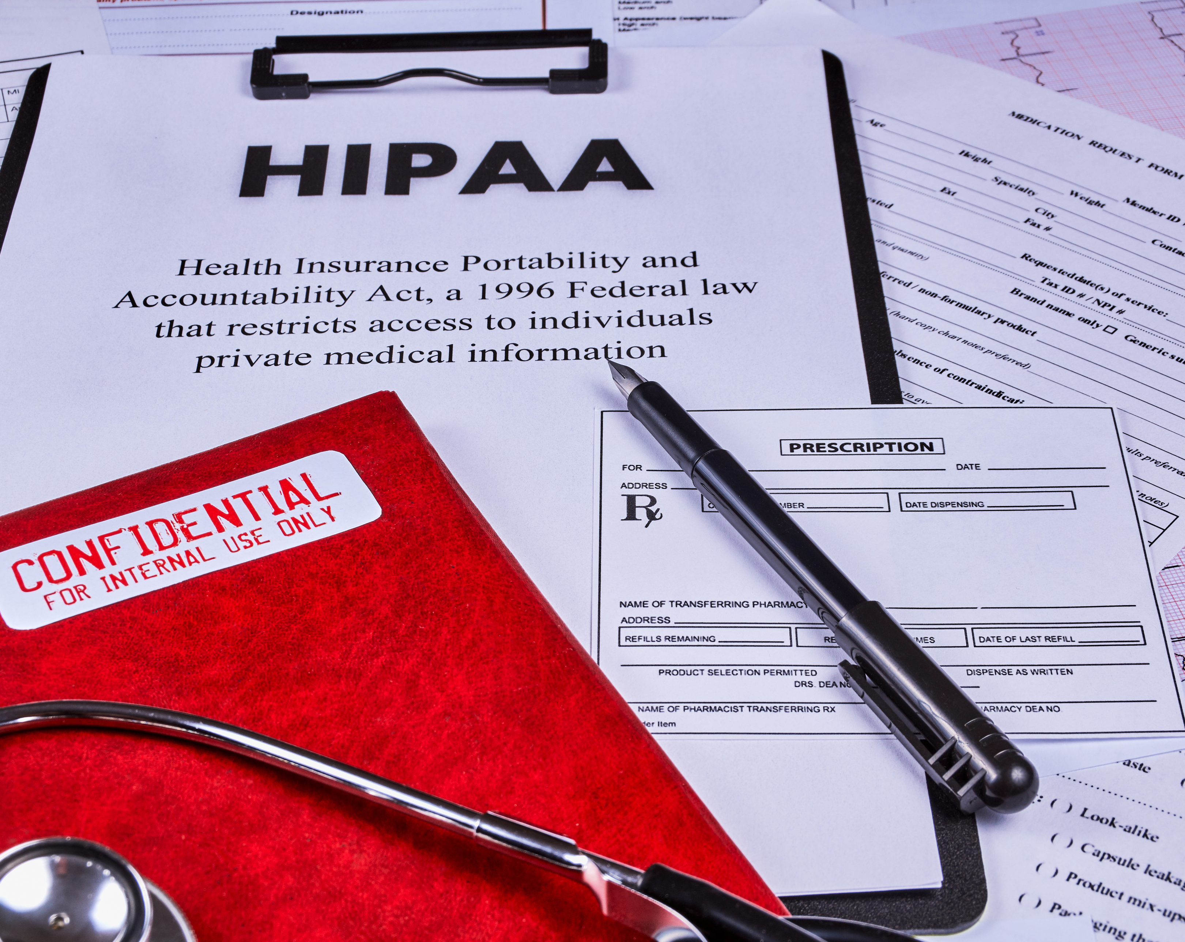
HIPAA Introduction

Slide 2


Ice Breaker
Directions:
Change your background photo to a picture from your hometown or major city that you live by (ex if you live in Katy, TX you would use Houston as your major city).
In the chat, guess where at least one person is from.
Give one or two hints if need be before revealing your home town.
Guess the hometown!
Hometown of basketball player Shaquille O’Neal
Houses the Hockey Team the New Jersey Devils
Has the largest number of cherry blossom trees in the US.

Slide 3

Ground Rules
Have your camera on as much as possible.
Be an active participant.
Remain muted, unless actively speaking to avoid “hot miking”.
Use raise hand or chat feature to ask questions.

Slide 4

Objectives
Name what each letter in the acronym H.I.P.A.A stands for.
List one or two ramifications that can occur if you violate HIPAA

Slide 5


Slide 6

HIPAA: what words come to mind when you see that word/acronym?
Drop them in the chat!

Slide 7

HIPAA
Health
Insurance
Portability
Accountability
Act
Notes:
Founded in 1996 and signed into law by President Bill Clinton.
Original goal was to ensure that more Americans would get health insurance coverage
Also created so that employees would not lose their current health insurance while switching jobs.
Privacy rule added in 1999 to safeguard protected health information.

Slide 8

What is PHI ?
Protected Health Information: any information within a person’s medical record that can identify them.
On the next slide we are going to name some of the examples of items that are considered PHI.

Slide 9
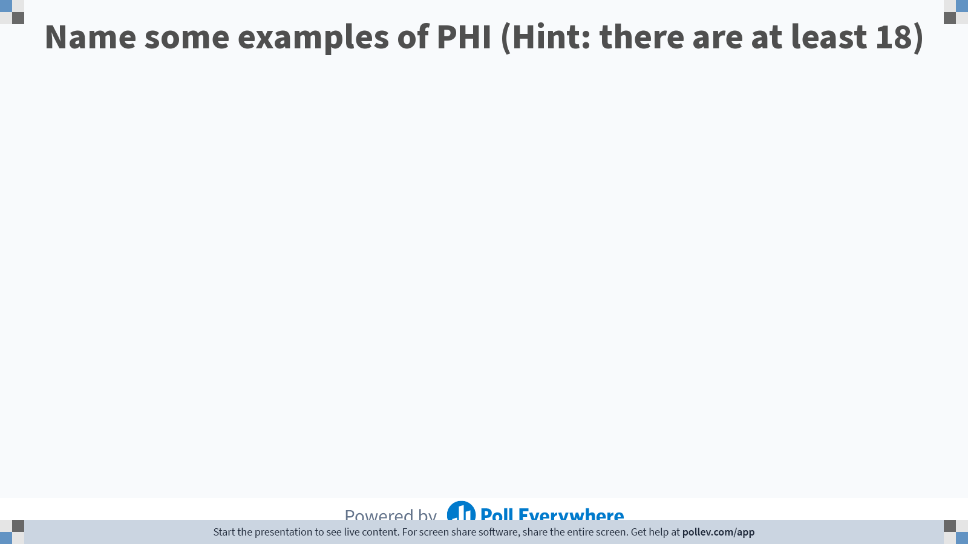
Notes:
Do not modify the notes in this section to avoid tampering with the Poll Everywhere activity.
More info at polleverywhere.com/support
Name some examples of PHI (Hint: there are at least 18)
https://www.polleverywhere.com/free_text_polls/bWenhG3AsnMI21SH791j5

Slide 10
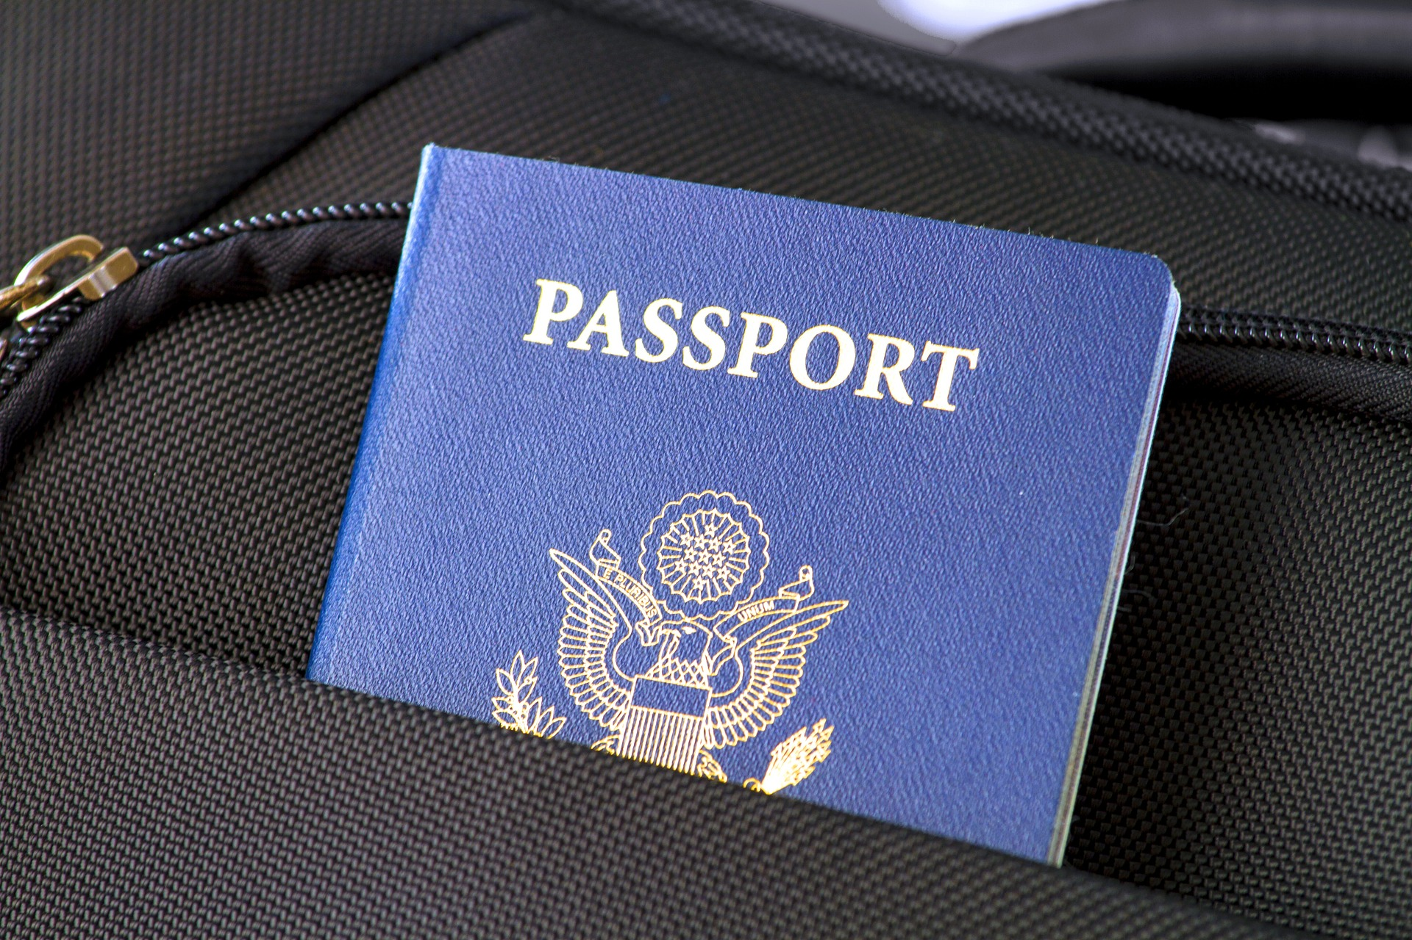
Examples of PHI
Name
Address
Any dates (excluding years)
Telephone number
Fax number
Email address
Social Security number
Medical record number
Health plan beneficiary number
Account number
Certificate/license number
Vehicle identifiers
Full face photos

Slide 11

HIPAA’s Five Rules
The Privacy Rule
The Security Rule
Breach Notification Rule
Omnibus Rule
Enforcement Rule

Slide 12

The Privacy Rule
Dictates how, when, and under what circumstances PHI can be used and disclosed.
Sets limits regarding the use of patient information when no prior authorization has been given.

Slide 13

The Security Rule
Five parts to the rule
  The general rules aka the flexibility of approach”
  The administrative
  The physical
  Technical Safeguards
  Organization Requirements

Slide 14

The Breach Notification Rule
If there is a breach, the department of health and human services must be notified.
Notification Guidelines:
  If the breach involves 500 or more individuals, notification must be made within 60 Days.
  If the breach involves less than 500 individuals, notification must be made within 60 days of the end of the calendar year.

Slide 15

The Omnibus Rule
Regulations for using patient information for marketing purposes.
Includes a provision that requires healthcare providers to report data breaches that are deemed unharmful.
Requires businesses and subcontractors to utilize HIPAA’s privacy and security guidelines.

Slide 16
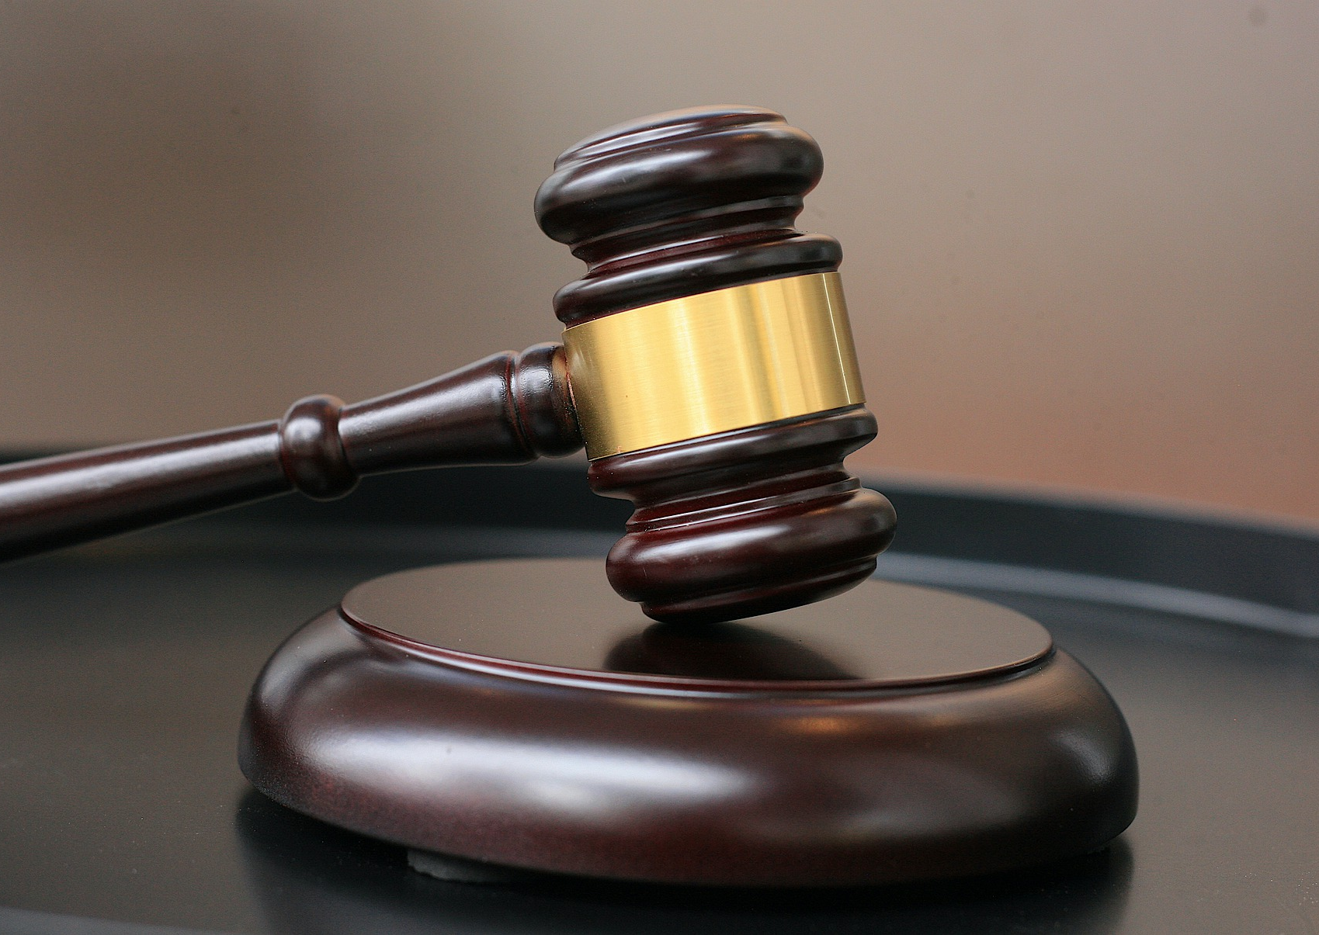
The Enforcement Rule
Explains how resulting investigations are carried out.
There are 4 levels of negligence, once the level is determined, then the appropriate fines are issued.

Slide 17

HIPAA Violations Penalties Corner
Tier 1:Fines range from $100-$50,000 per violation
Tier 2:Fines range from $1,000-$50,000 per violation
Tier 3:Fines range from $10,000-$50,000
Tier 4:$50,000 per violation

Slide 18

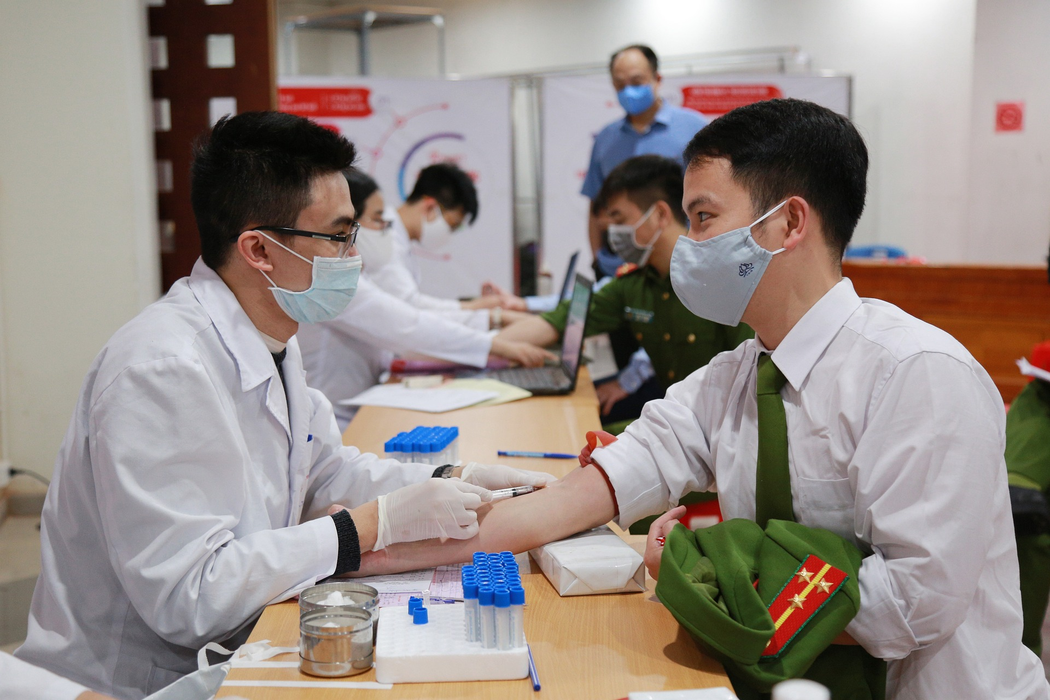
How to Protect Patient Information
Only have conversations regarding patients in secure locations.
Keep patient files in a secure location like a locked cabinet.
Never leave patient information on your desk and walk away.
Ensure that you get consent from the patient before revealing any PHI.
Report any HIPAA violations immediately.

Slide 19
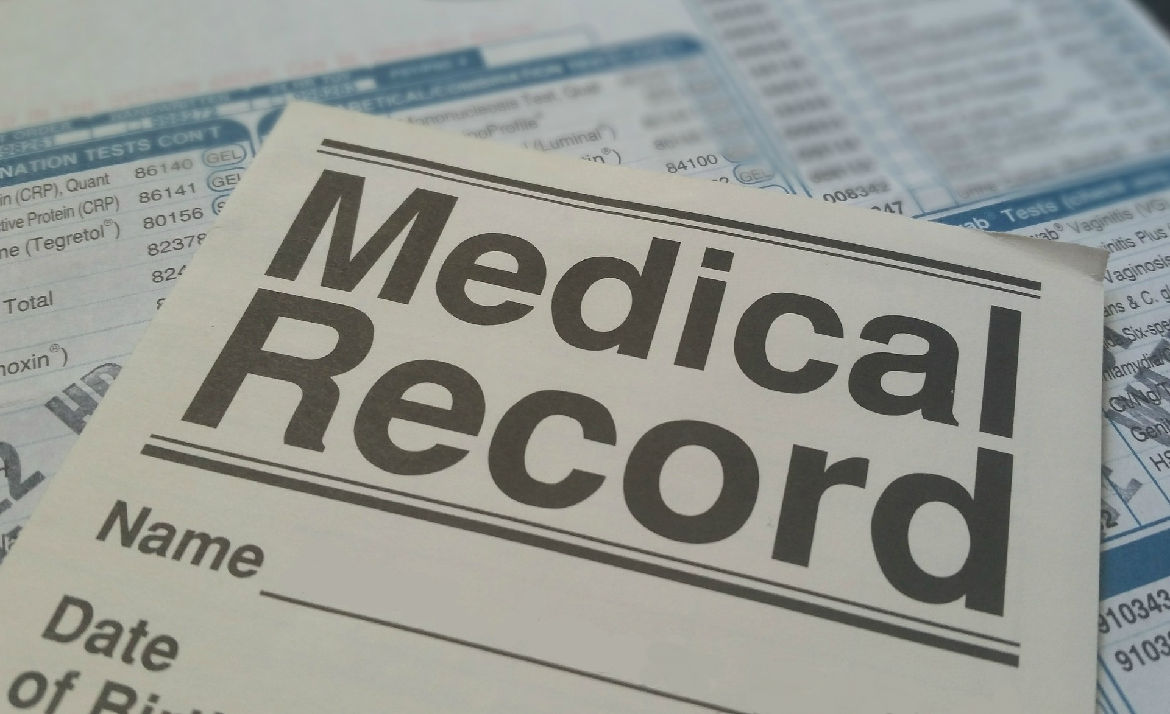
Summary
The Health Insurance Portability Act was created in 1996.
There are four tiers with various fine levels if you violate HIPAA.
Never have conversations about a patient’s medical record in a public setting.
HIPAA has five rules:
  Privacy Rule
  Security Rule
  Omnibus Rule
  Enforcement Rule
  Breach Notification Rule

Slide 20
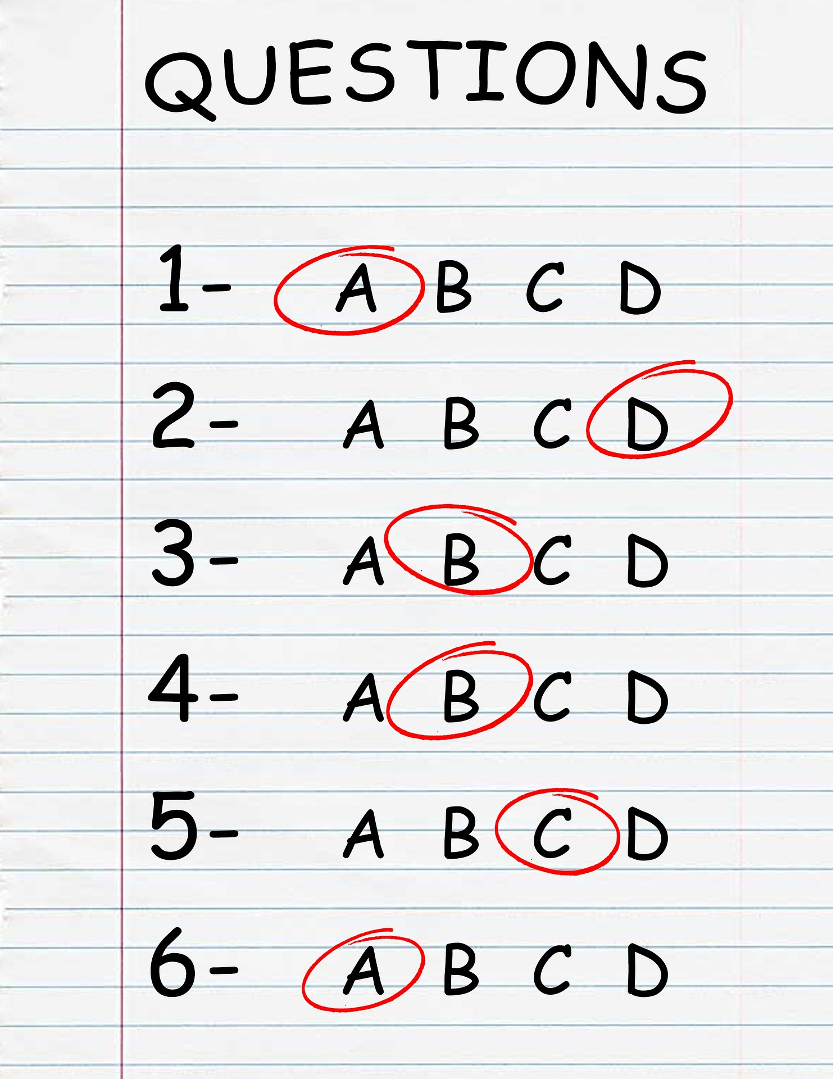
Quiz Time
Time for an interactive quiz to see what you learned.
The quiz was created using the poll everywhere app.
Please go to https://www.pollev.com/tashenamalloy770 to participate
When you have logged in: use the thumbs up reaction
If you need help: use the raised hand reaction

Slide 21
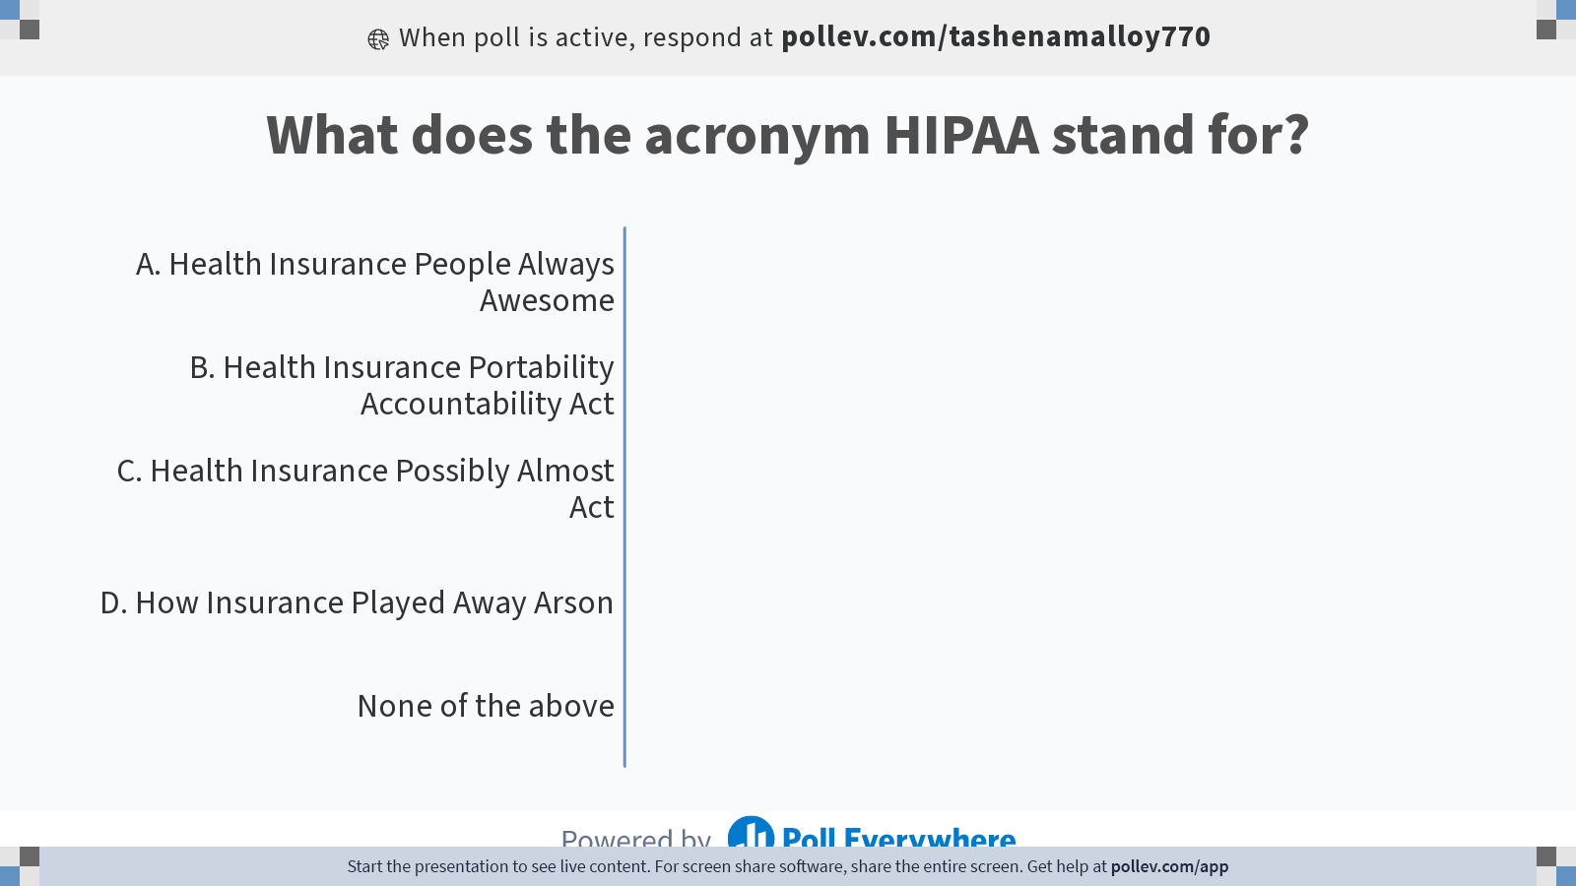
Notes:
Do not modify the notes in this section to avoid tampering with the Poll Everywhere activity.
More info at polleverywhere.com/support
What does the acronym HIPAA stand for?
https://www.polleverywhere.com/multiple_choice_polls/igg3OwCmN9cqPjPBLynOF?state=opened&flow=Default&onscreen=persist

Slide 22
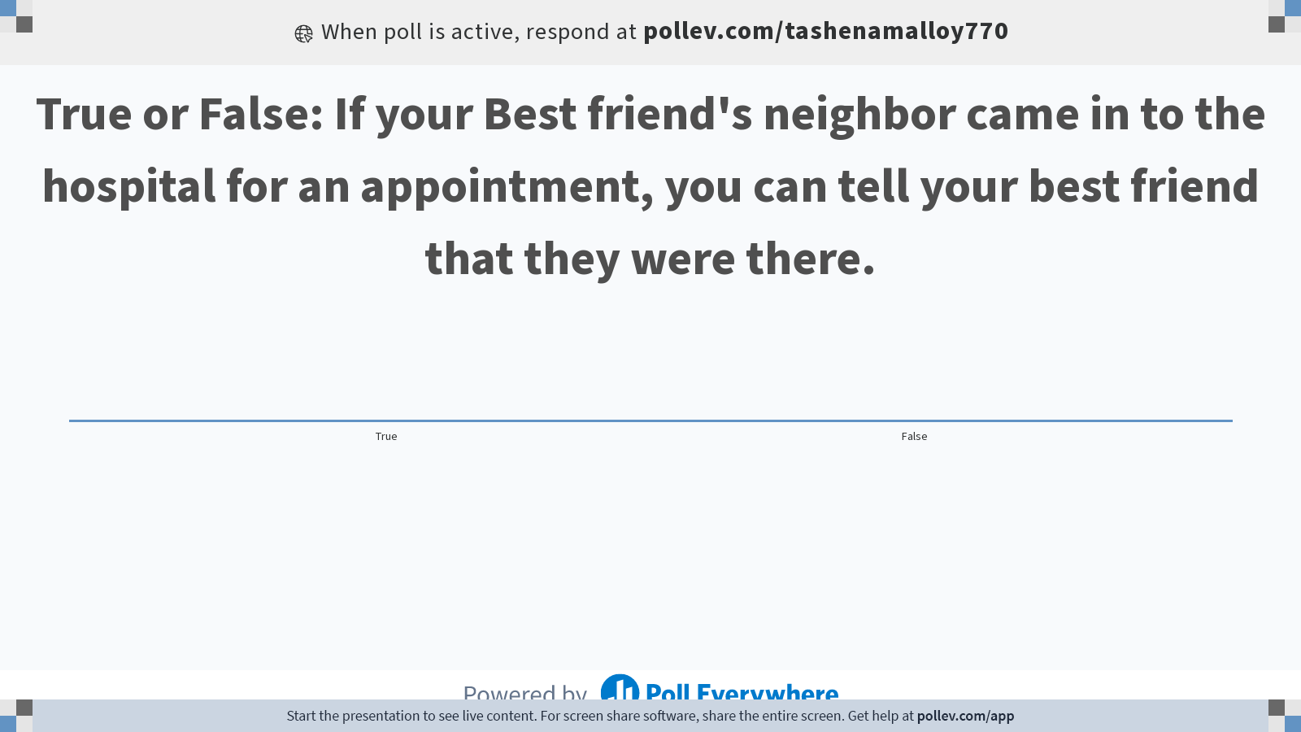
Notes:
Do not modify the notes in this section to avoid tampering with the Poll Everywhere activity.
More info at polleverywhere.com/support
True or False: If your Best friend's neighbor came in to the hospital for an appointment, you can tell your best friend that they were there.
https://www.polleverywhere.com/multiple_choice_polls/NhqRmNYsLvLdaGZQ1lIwB?state=opened&flow=Default&onscreen=persist

Slide 23
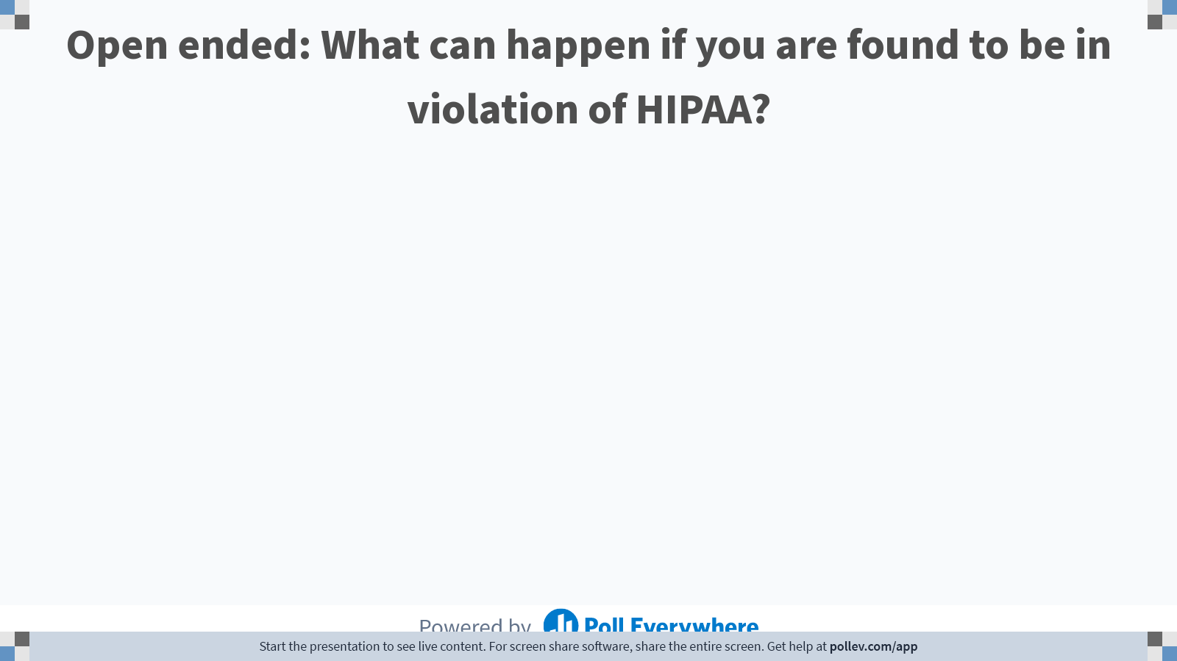
Notes:
Do not modify the notes in this section to avoid tampering with the Poll Everywhere activity.
More info at polleverywhere.com/support
Open ended: What can happen if you are found to be in violation of HIPAA?
https://www.polleverywhere.com/free_text_polls/cUVraxBXzgZYucbwPhZ5l

Slide 24


Let’s take a minute to decompress!
Take a deep breathe.
Think of your favorite vacation spot (or somewhere you would like to visit).

Slide 25

Final Thoughts
What was your biggest takeaway from this course?
How will you protect patient information going forward to stay in compliance with HIPAA?
Any final questions?

Slide 26

Thank you!
Enjoy the rest of your day!

